Slide 1


Topic : Voice-Controlled Gaming Tools for Enhanced Learning in the Skill Ecosystem Domain : Innovation Team ID : T188 Team name : T188 Team members : M Sai Teja(2303A51930) D Lokesh Reddy(2303A510J3) B Kruthik Reddy(2203A51837) Sandeep(2303A510G1)

Slide 2
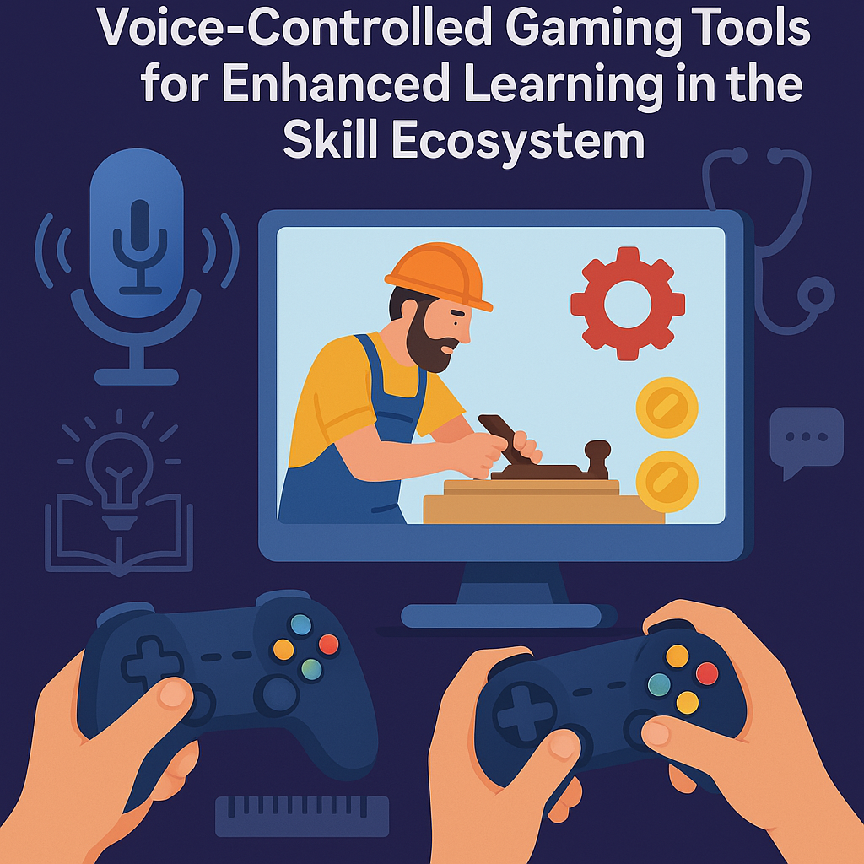

Objective
Purpose of the Project:
Develop interactive, voice-controlled gaming tools to
enhance skill-based learning.
Improve engagement and retention of vocational skills
through immersive experiences.
Ensure accessibility for all learners, including those with
disabilities.
Expected Outcomes:
Higher learner engagement and knowledge retention.
Gamified assessment for real-time skill evaluation.
AI-driven personalized learning experiences

Slide 3
Problem Statement
Current Challenges in Skill Training:
Lack of engaging, interactive learning methods.
Limited accessibility for learners with disabilities.
Traditional assessment methods are time-consuming and less adaptive.
Inability to simulate real-world vocational tasks effectively.
Pain Points:
Passive learning experience.
High cost of hands-on training equipment.
Need for personalized learning pathways.

Slide 4
Existing system
. Current Learning Methods:
Classroom-based lectures.
Video-based tutorials.
Physical practice sessions with trainers.
Limitations:
Non-interactive and passive learning.
Limited scalability across different skill disciplines.
High dependency on human trainers.

Slide 5
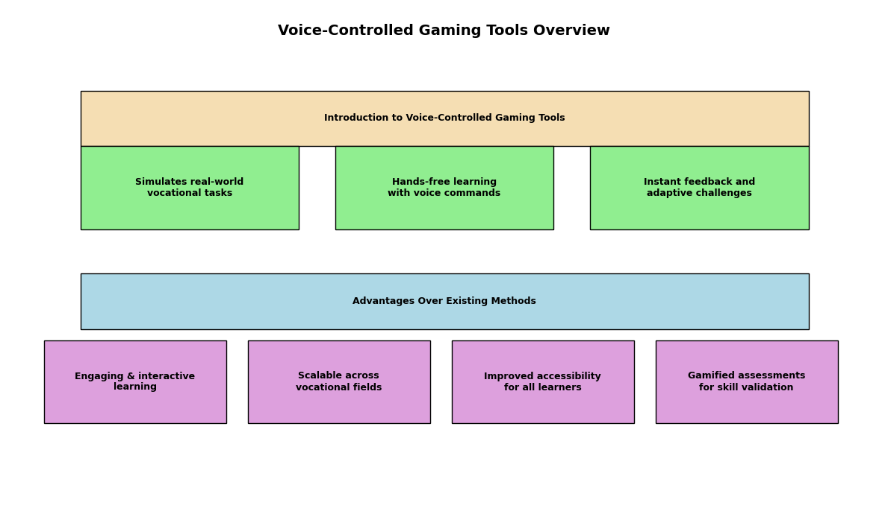
Proposed system

Slide 6
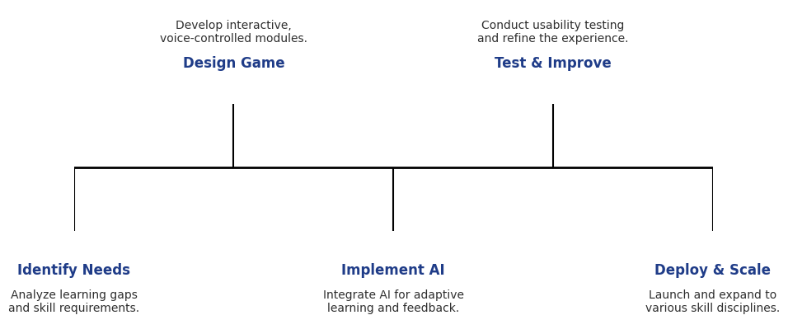
Workflow
Keep the diagram uncluttered and readable.
Step 04
Step 02
Step 01
Step 03
Step 05
Display a flowchart showing the system process.
Use arrows to indicate process flow.
Provide a brief explanation alongside the diagram.

Slide 7
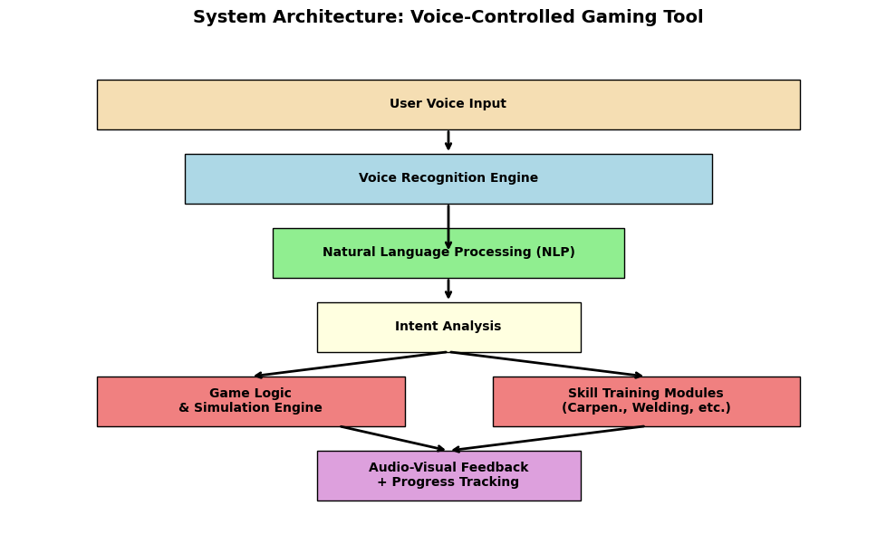
System Architecture
Tech Stack
Languages used (C++, Html, Css, Js )
Show the system’s technical structure.
Use a layered or block diagram.
Label different components and their interactions.
Keep the explanation brief and precise.
Maintain a clean and organized layout.
Database: Cloud-based storage for tracking learner progress
Cloud Hosting: AWS or Firebase for scalability
APIs Used:
Google Speech-to-Text API
Unity Game Engine for interactive environments

Slide 8
Conclusion & Future Scope
Key Takeaways:
Enhances engagement, accessibility, and personalized learning.
Provides real-world vocational training in a virtual, controlled environment.
Offers scalable and adaptable solutions for various industries.
Future Enhancements:
Integration with AR/VR for an even more immersive experience.
Expansion to additional vocational fields.
Multilingual voice command support for wider accessibility.

